Slide 1
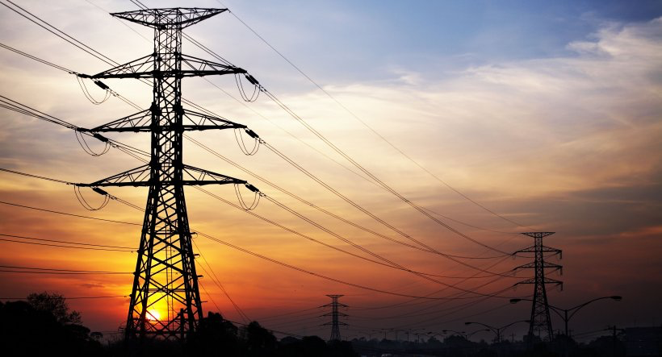
Capstone 2: US Electrical Outage Analysis
Data from US outages can inform investment decisions to improve resiliency

Slide 2
1
Data from major US electrical outages (including location, root cause, weather, and energy supply/demand) from 2018 – 2023 was compiled and analyzed
2
Several key areas were identified as potential candidates for cost-effective investments to improve grid reliability: reducing vandalism and weather-proofing in hotter climates (e.g., California)
Executive Summary
3
Snowfall and precipitation did not seem have as much of an impact on outages as higher temperatures.
4
Opportunities for follow-on analysis have been identified to guide optimal investment strategies and minimize future outages in a cost-effective manner

Slide 3
Problem Statement and Key Findings
Problem Statement:
Based on electric grid outage data from 2018 - 2023, in which geographic areas and in which infrastructure should investments be made to have the greatest positive impact on grid reliability in the next 2 decades?
Key Findings:
~46%
of outages were caused by severe weather
~17%
of outages were caused by vandalism
5
states account for over 50% of outages
< 5%
of outages seem to be caused by heavy snowfall
Most of these outages caused by severe weather occurred during period of elevated temperature - building additional generating capacity where high temperatures are prevalent or weather-proofing against wildfires could mitigate significant numbers of outages.
Protecting against vandalism may be a cost-effective way to prevent a significant number of outages.
Focusing investment on generation capacity and vandalism prevention in these 5 states would have an outsized effect on outage prevention.
Infrastructure investments to further weather-proof the grid against precipitation or snowfall may not be the best allocation of capital.

Slide 4
Analysis Process Overview
The steps below were used to build a model which provided statistical insights and produced clusters of major electrical outages in the US from 2018-2023
Problem Identification
Data Wrangling
Exploratory Data Analysis
Preprocessing & Training
Modeling
In November of 2022, the government allocated $13B to improve electric grid resilience and reliability. This study sought to understand the factors which have the greatest impact on grid reliability, how these factors contribute to grid reliability, and assess where funds would best be used to improve electric grid reliability.
Obtained and cleaned data from the following sources:
Major US outages from 2018 – 2023 from the DOE
State weather conditions during the day of each outage from NOAA
Energy supply and generation for each region during month of the outage from NERC
Gathered insights about major US outages by analyzing feature statistics.
Key takeaways:
Many outages occur at higher temperatures – snowfall may not have as large of an impact
Vandalism is a significant cause of outages, accounting for >17% of outages
5 states are responsible for > 50% of outages
Created dummy variables for categorical columns and standardized numerical columns for modeling purposes.
Modeled using unsupervised clustering methods to include KMeans, MeanShift, Hierarchical Clustering, and DBSCAN.
Reduced dimensions of the dataset via t-SNE and PCA to visualize the cluster.
The best clusters were formed by KMeans with 4 clusters.

Slide 5
Data Wrangling
Obtained and cleaned data from the following sources:
Major US outages from 2018 – 2023 from the Department of Energy (DOE)
Contained information in a separate excel for each year of outages
Had to be extensively cleaned to align formats and columns between excel files
State weather conditions during the day of each outage from National Oceanic and Atmospheric Administration (NOAA)
Obtained data from the NOAA API for each outage
Gathered temperature, windspeed, precipitation, and snowfall data for each station within the affected state and averaged the readings to obtain the value included in the analysis
Energy supply and generation during month of the outage from North American Electric Reliability Corporation (NERC)
Obtained monthly peak demand and net energy supply for the region of the outage in excel format
Was not able to obtain energy data on a more frequent basis
The resulting dataset contained information regarding 419 outages (i.e., 419 rows) and 12 features for each outage.

Slide 6
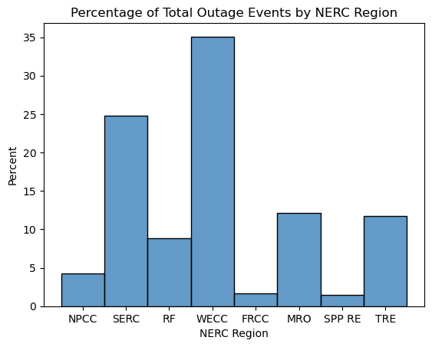
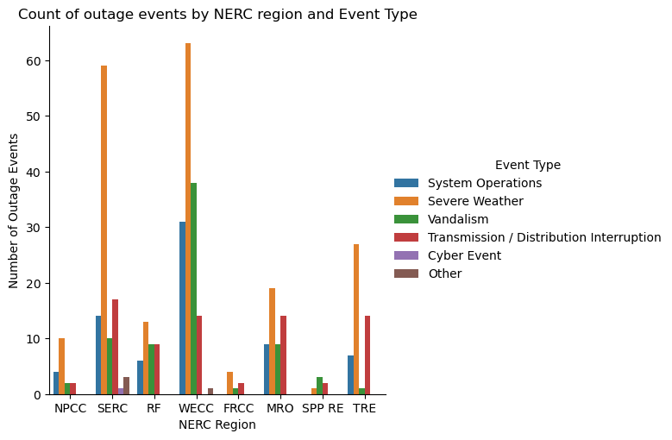
EDA: Histograms of Outage Events by NERC Region
Histogram of outage events by NERC Region and Event Type
WECC and SERC account for well over half of all US major outages. These geographic areas (the west and south) tend to be hotter and subject to more extreme weather events such as wildfires and hurricanes
Vandalism, especially in the WECC region, is an especially prevalent source of major outages. This could present an opportunity to provide a cost-effective measure in preventing many future outages – security may be less expensive than building new infrastructure. Overall, vandalism accounts for >17% of all major US outages.
WECC, accounting for ~35% of all outages, is by far the largest geographic region, covering most of the American west, which tends to be hot and have large wildfires.
Vandalism accounts for > 25% of all WECC outages. Providing security against vandalism is a potentially cost-effective path towards preventing a significant number of future outages.

Slide 7
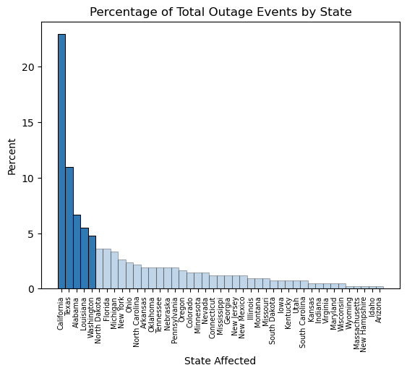
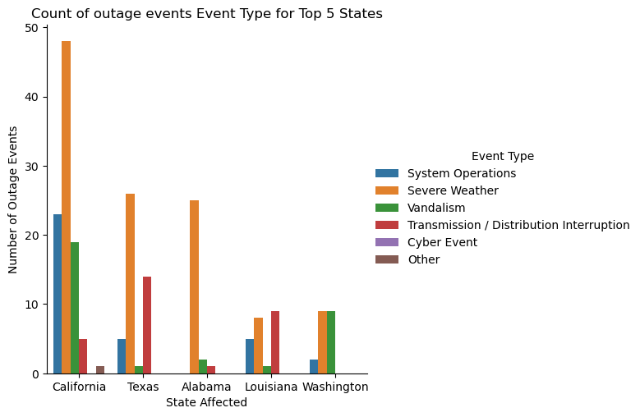
EDA: Histogram of Outages by State
Histogram of outage events by State and Event Type
The top 5 states of California, Texas, Alabama, Louisiana, and Washington account for > 50% of all major US outages, focusing on these 5 states may provide insights into the best allocation of investments for grid reliability
Severe weather and vandalism cause a significant number of outages in California. Wildfires are a major source of severe weather in California – further studies relating wildfires to outages should be examined. Weather proofing infrastructure (e.g., moving lines underground) may combat outages due to wildfires.
Preventing vandalism in California would lower the amount of major US outages by ~ 5%
The top 5 states of California, Texas, Alabama, Louisiana, and Washington account for > 50% of all major US outages

Slide 8
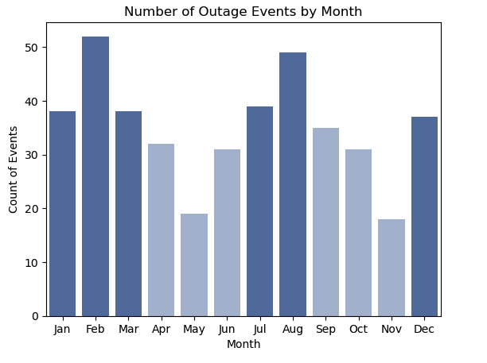
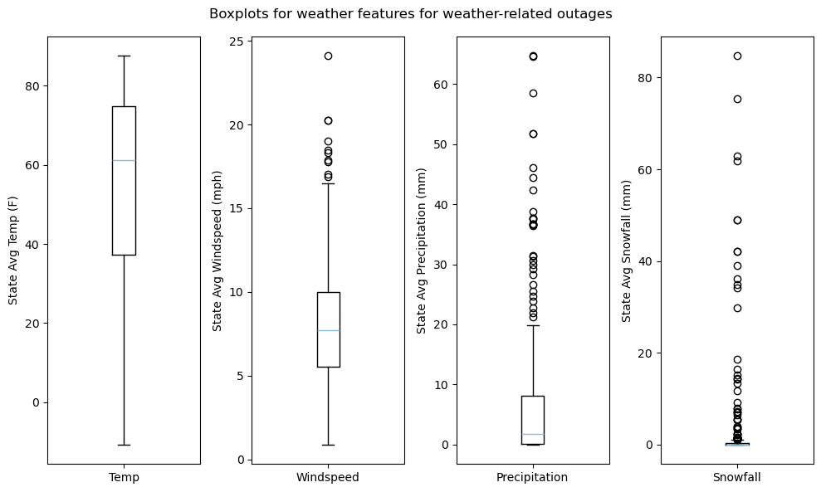
EDA: Weather Effects on Outages
Analysis of weather impacts on outages
More outages occur during Winter and Summer rather than Spring and Fall. More outages seem to occur during Wintertime vs. Summertime.
Although more outages seem to occur during Winter vs. Summer, most of the outages seem to occur at relatively high temperatures. Even in Winter, most outages occur at temperatures above freezing.
Snowfall and precipitation levels are very low during most outages. It seems as if snowfall and precipitation have a low probability of causing outages.

Slide 9
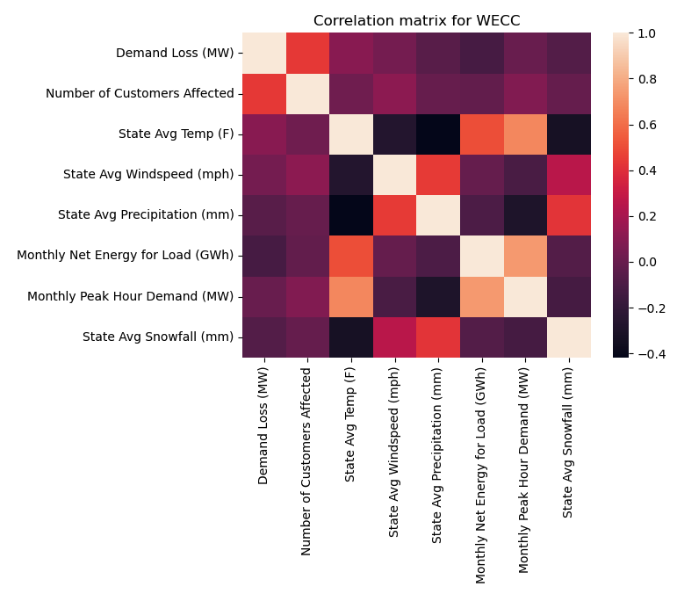
EDA: Correlation between Features
Correlation Heatmap of Numeric Features for WECC Region
The positive correlation between temperature and energy demand makes outages more likely.
As the energy generation capacity of NERC regions during higher temperatures is pushed to the limit there is less flexibility to bring on additional sources of energy to combat fluctuations in demand or counteract weather events.
Building additional generating capacity where high temperatures are prevalent could mitigate significant numbers of outages.
Monthly peak hour demand (MW) and State Avg Temp (F) are highly positively correlated – as temperatures rise, so does the demand on the electrical grid

Slide 10
Model Build and Results
Four clustering models were built to gain additional insights into the data. KMeans clustering with n_clusters = 4 provided the most useful grouping of outages
Four clustering models were built and visualized in reduced dimensions:
The following four clustering models were built:
# | Model Name | Hyperparameters | Results
1 | KMeans | n_clusters = 4 This parameter was tuned by using the elbow method for inertia | This produces somewhat distinct and relatively evenly distributed clusters. This was the best model.
2 | MeanShift | Bandwidth estimated using sklearn built-in functionality | Number of clusters = 5, however clusters were imbalanced as nearly all ended up in one cluster
3 | Hierarchical | Complete linkage | Linkages showed 6 distinct clusters of outages. The majority of the outages were all in one group.
4 | DB Scan | EPS = 2.0. Model was built using a range of EPS values, 2.0 produced a reasonable number of clusters | Outages were separated into 5 distinct clusters, but many events were classified as noise. Clusters were not separated very well
The dataframe’s dimensions were reduced using t-SNE and PCA:
Method | Parameters | Results
t-SNE | Learning rate = 150, a plot was formed with a range of learning rates to determine optimal | Reduced dimensions to 2 with clear separation of clusters on KMeans models
PCA | Explained variance was plotted as a function of number of PCA components | 6 dimensions were required to explain ~80% of the variance.
KMeans with n_clusters = 4 was the best model and was able to be visualized well with t-SNE dimension reduction.

Slide 11
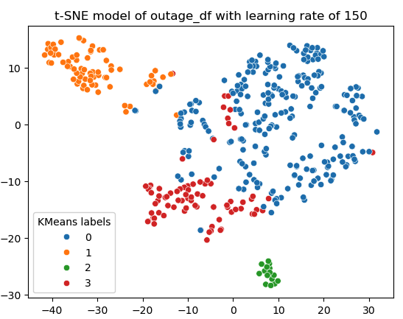
Model Analysis
Clusters were analyzed via crosstab tables and analyzing the descriptive statistics of features for events within each cluster.
Crosstab of KMeans labels and NERC Region:
NERC Region | FRCC | MRO | NPCC | RF | SERC | SPP | TRE | WECC
KMeans Labels
0 | 0 | 36 | 3 | 26 | 60 | 0 | 0 | 123
1 | 7 | 0 | 11 | 1 | 0 | 6 | 49 | 1
2 | 0 | 2 | 0 | 2 | 0 | 0 | 0 | 11
3 | 0 | 13 | 4 | 8 | 44 | 0 | 0 | 12
Crosstab of KMeans labels and Event Type:
Event Type | Cyber Event | Other | Severe Weather | System Operations | Distribution Interruption | Vandalism
KMeans Labels
0 | 1 | 4 | 85 | 49 | 50 | 59
1 | 0 | 0 | 40 | 9 | 20 | 6
2 | 0 | 0 | 11 | 2 | 0 | 2
3 | 0 | 0 | 60 | 11 | 4 | 6
Key callouts:
Most of the western outages are in cluster 0. Cluster 1 contains all the outages from Texas, Florida, and SPP
Vandalism seems to be included in cluster 0, while distribution interruptions are primarily in cluster 0 and 1. Severe weather seems spread evenly throughout
Cluster 2 seems to contain colder temperatures and larger amounts of snowfall - perhaps this is the defining characteristic of cluster 2. Very few are included in this cluster which is consistent with few outages being caused by heavy snowfall

Slide 12
Opportunities for Further Analysis
A follow-on study with more specific weather and geographic data would help identify best regions for investment.
A follow-on analysis of the cost and benefits of providing security at critical infrastructure points would help guide allocation of capital investments to prevent vandalism.
A follow-on study regarding specific sites within the top 5 states would determine optimal investment strategies to combat state-specific causes of outages.
A follow-on study to confirm the low impact of heavy snowfall using more specific weather data.

Slide 13
Questions?

